Slide 1

Stacked OmniStereo Representation for Virtual Reality with Motion Parallax
Jayant Thatte

Slide 2


Perceptual Factors
Stacked OmniStereo
Construction
Rendering

Slide 3
Perceptual Factors
Stacked OmniStereo
Construction
Rendering

Slide 4
Overall Quality of Experience
Size Perception
Perceptual Factors
Stacked OmniStereo
Construction
Rendering

Slide 5
Overall Quality of Experience
Size Perception
Perceptual Factors
Stacked OmniStereo
Construction
Rendering

Slide 6
Overall Quality of Experience
Goal: To understand the contributions of (1) motion parallax and (2) binocular stereopsis towards perceptual quality in VR
VR Test Settings: {mono, stereo} x {no parallax, only horizontal, full parallax}
3-DoF
5-DoF
6-DoF
Left- Right
Looming- Receding
Up- Down
Stanford University Jayant Thatte 06

Slide 7
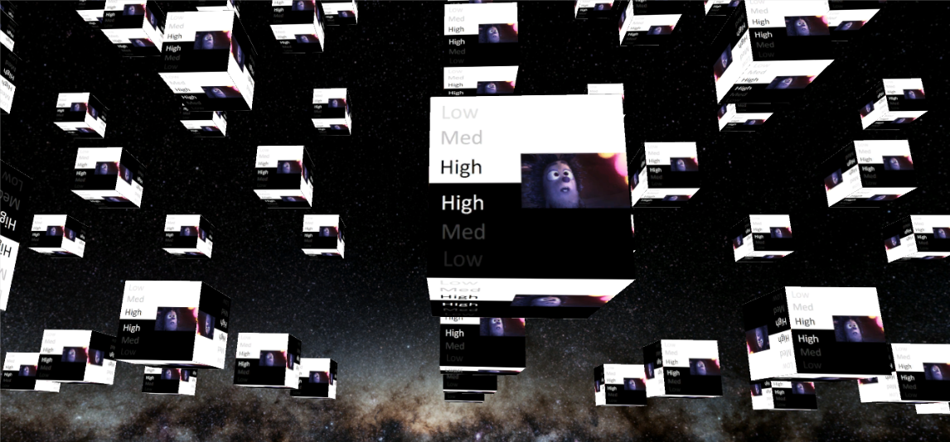
Test scene (Unity): Floating cubes 1m to 4m from the viewer, background at infinity
Stanford University Jayant Thatte 07
Notes:
Add cubes image

Slide 8
Subjective Study
Test Format: 30 pairs of stimuli per subject, 10 seconds per stimulus
Rating Scheme: Comparison Category Rating scheme on 7 point scale (-3 to +3) [ITU Standard P.913, March 2016]
Head Trajectories: We record 6-DoF HMD pose at 90 Hz using Rift positional tracking sensor
Participants: 17 test subjects
Stanford University Jayant Thatte 08

Slide 9
Subjective Study: Results
Motion parallax is more important than stereo
When both horizontal and vertical motion parallax is supported, stereo is much more preferred than mono
With limited or no motion parallax, stereo does not lead to a better quality of experience
M
S
M
S
M
S
Error bars show ±1 standard deviation of sample mean
M = Mono S = Stereo
Stanford University Jayant Thatte 09

Slide 10
Subjective Study: Results
Scene 1: Depth range 0 -- 1 Diopters
Scene 2: Depth range 0 -- 1/4 Diopters
S
S
M
S
S
M
S
M
S
M
M
Error bars show ±1 standard deviation of sample mean
M
M = Mono S = Stereo
M = Mono S = Stereo
Stanford University Jayant Thatte 10

Slide 11
Overall Quality of Experience
Size Perception
Perceptual Factors
Stacked OmniStereo
Construction
Rendering

Slide 12
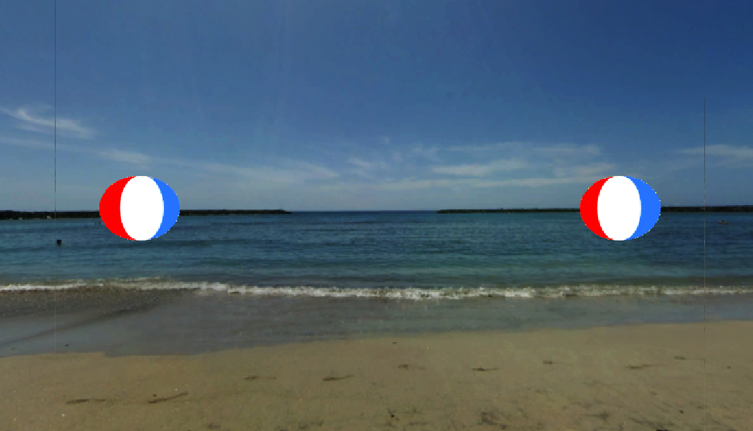

Ratio
M
S
S
Distance
Stanford University Jayant Thatte 12

Slide 13
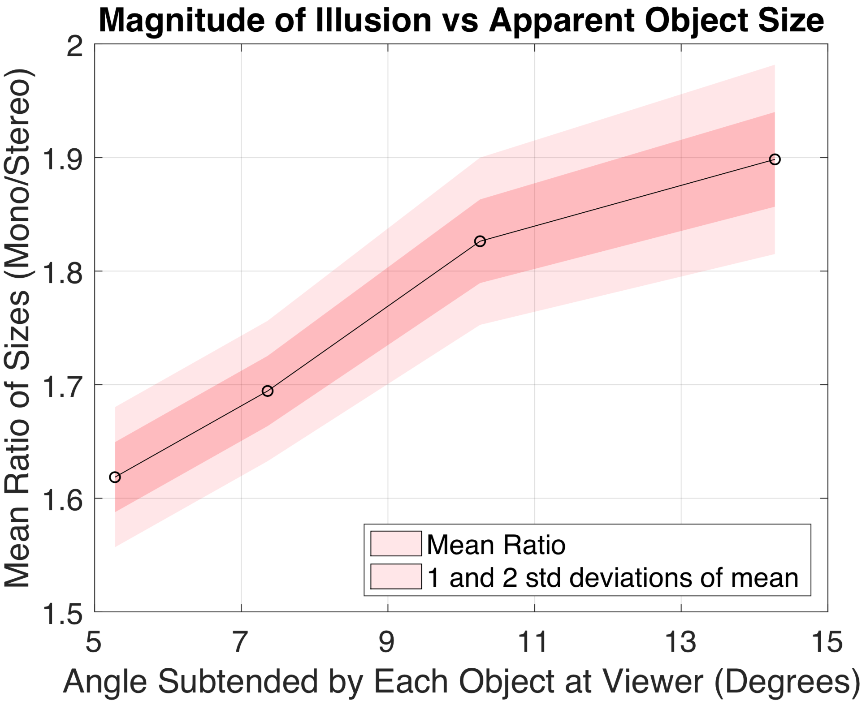
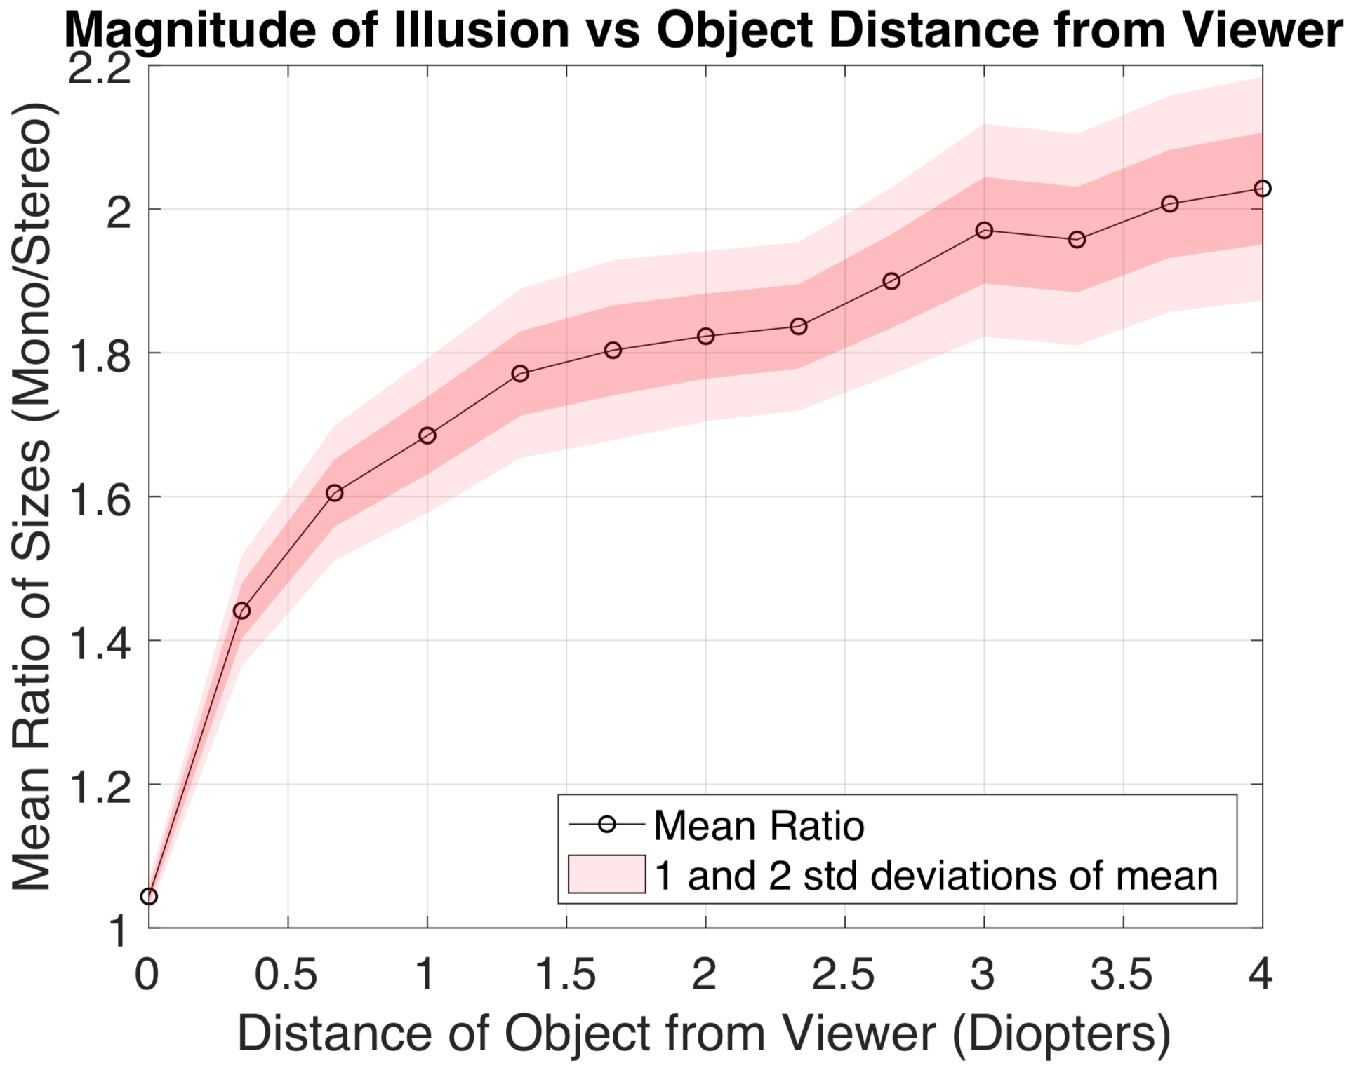
Stanford University Jayant Thatte 13

Slide 14
Perceptual Factors
Stacked OmniStereo
Construction
Rendering

Slide 15
Perceptual Factors
Stacked OmniStereo
Construction
Rendering

Slide 16
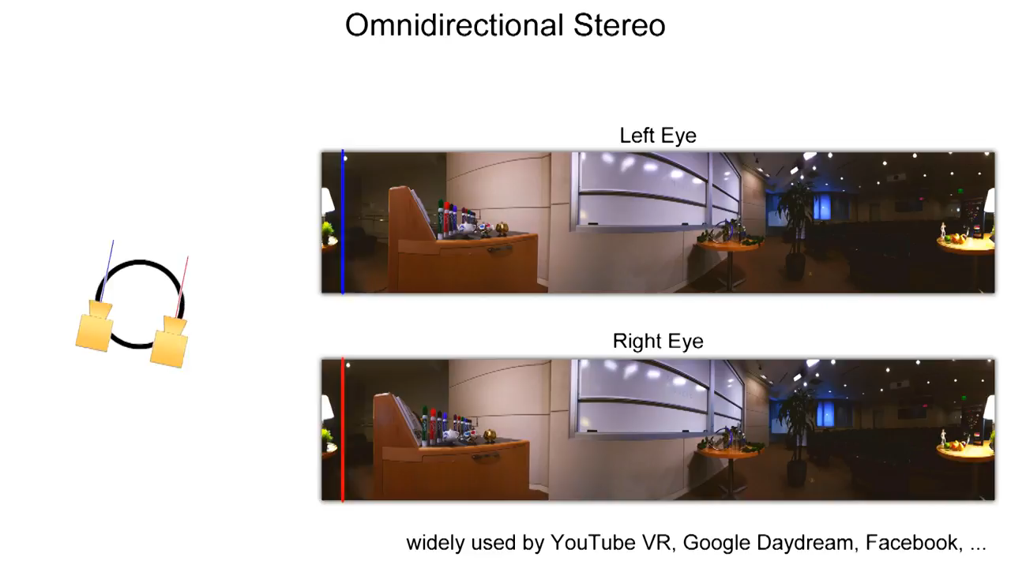
OmniStereo
Omnistereo: [Peleg 2001]
Video Reference: Spin VR [Konrad 2017]
Stanford University Jayant Thatte 16

Slide 17
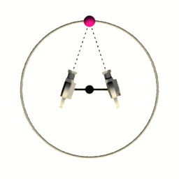
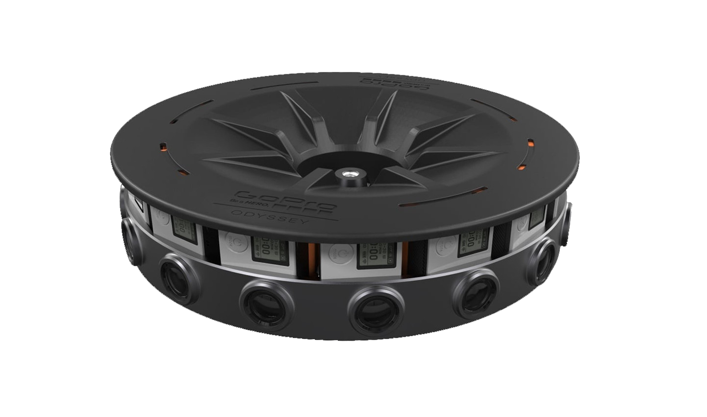
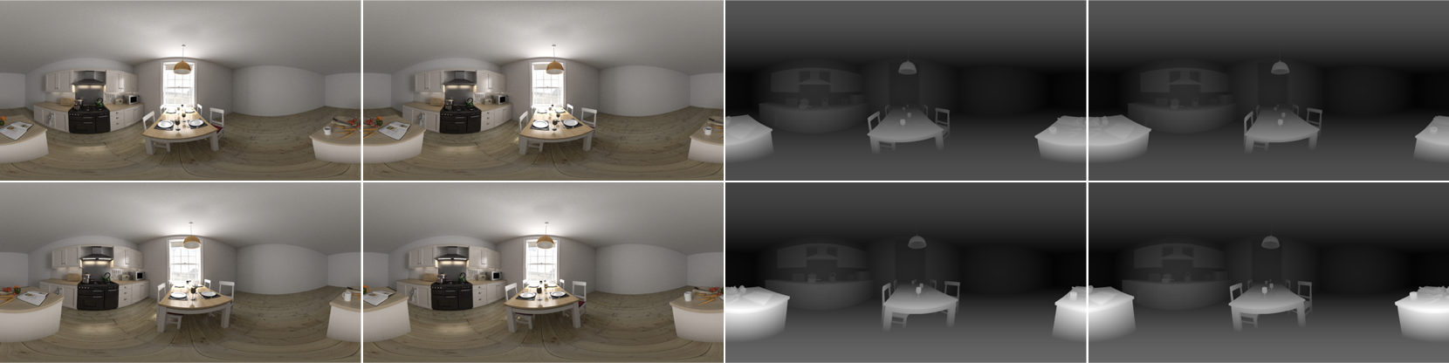
Stacked OmniStereo (SOS)
Omnistereo
+ depth
+ enlarged baseline
+ stacked
= Stacked OmniStereo
H
Viewing Volume
D = 6.5 cm
D = 40 cm
Stacked OmniStereo: [Thatte 2017]
D
Viewing volume used: D = 40 cm, H = 20 cm
Stanford University Jayant Thatte 17

Slide 18
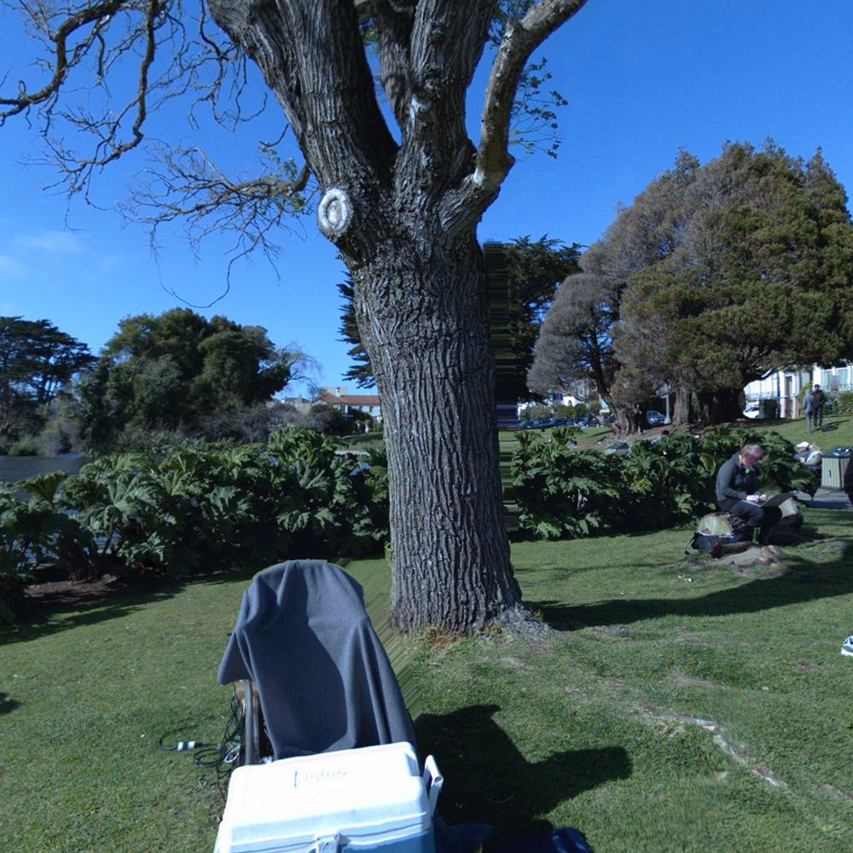

SOS: Importance of Wide Baseline
SOS: baseline = IPD = 6.5 cm
SOS: wide baseline = 30 cm
Stanford University Jayant Thatte 18

Slide 19
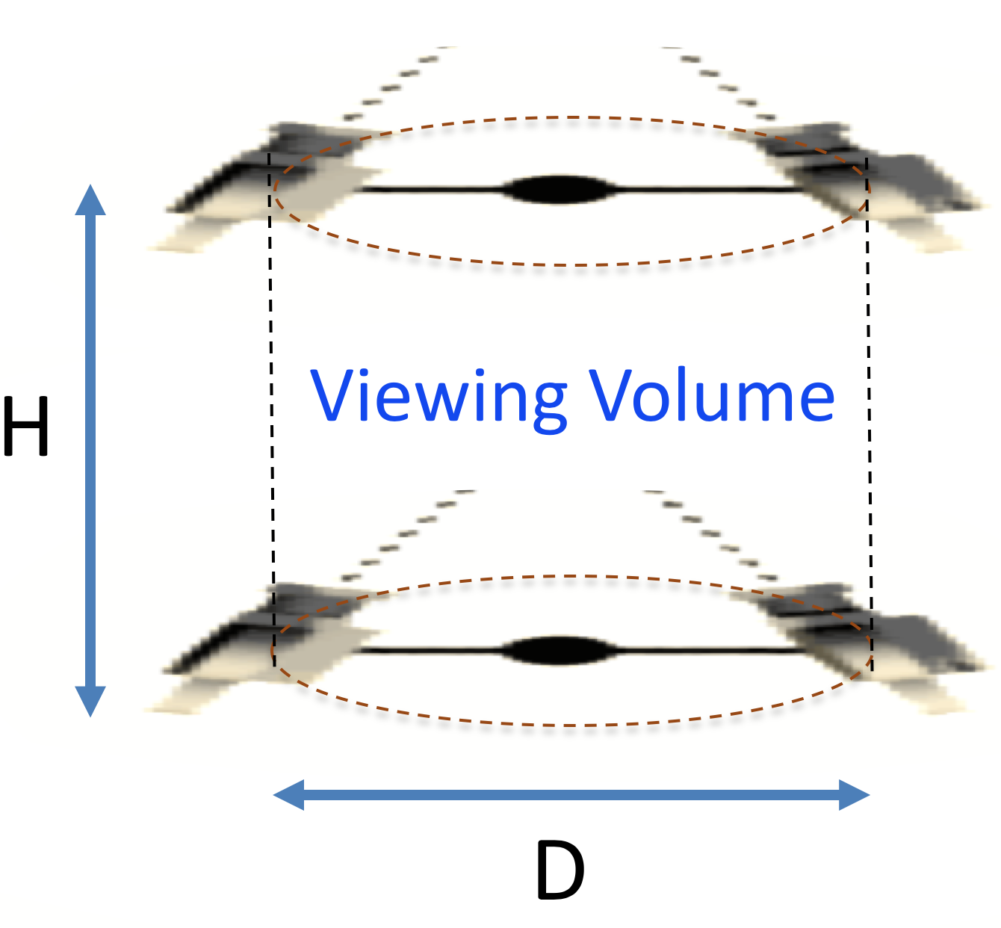
Perceptual Factors
Stacked OmniStereo
Construction
Rendering

Slide 20
Perceptual Factors
Stacked OmniStereo
Construction
Rendering

Slide 21
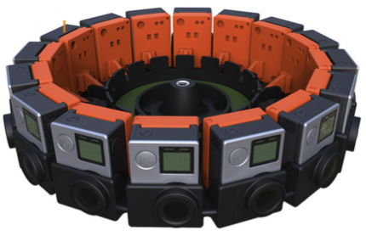
Rotating Cameras to Camera Rig
Real Camera
Real Camera
viewpoints
viewing circle
Omnistereo
[Peleg et al. 2001]
Stanford University Jayant Thatte 21

Slide 22
Virtual Camera using Interpolation
Real Camera
Real Camera
Real Camera
A
A
X
B
Real Camera
B
Virtual Camera
Intermediate slits are taken from virtual cameras interpolated using optical flow
viewing circle
viewing circle
a
x
b
Left Panorama
Omnistereo
[Peleg et al. 2001]
Stanford University Jayant Thatte 22

Slide 23
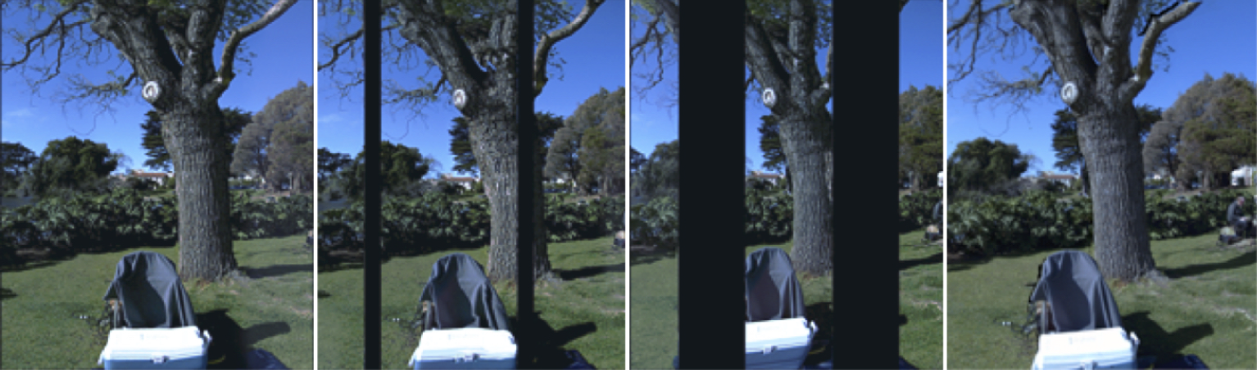
Extending to Wide Baseline Panoramas
What happens as we expand the viewing circle?
viewing circle
Enlarged section of output left panorama
Diameter = 6 cm
Stanford University Jayant Thatte 23

Slide 24
Extending to Wide Baseline Panoramas
Interpolated slits go outside the field of view of the real cameras
Enlarged section of output left panorama
Diameter = 12 cm
viewing circle
Stanford University Jayant Thatte 24

Slide 25
Extending to Wide Baseline Panoramas
This leads to missing regions in the panorama
Enlarged section of output left panorama
Diameter = 18 cm
viewing circle
Stanford University Jayant Thatte 25

Slide 26
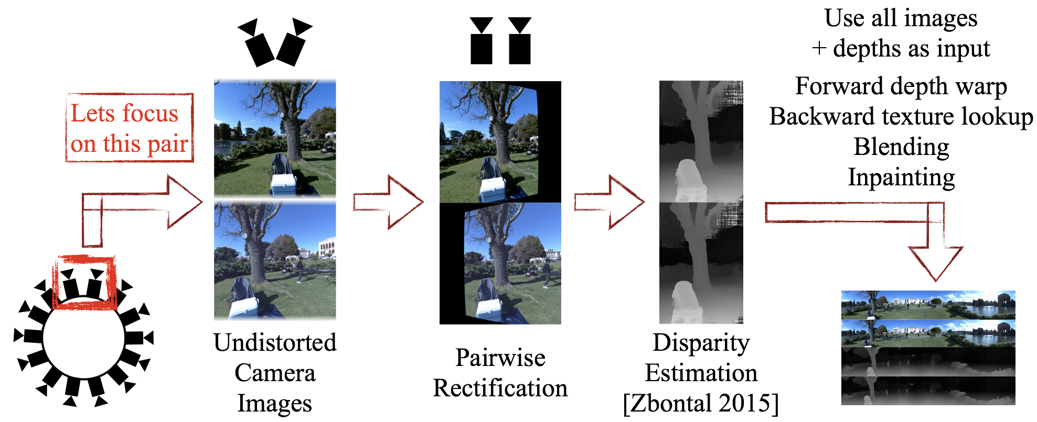
Proposed Multi-Camera Algorithm
We use all cameras from the rig jointly
Multi-camera algorithm can generate wide-baseline panoramas
Enlarged section of output left panorama
Diameter = 30 cm
Stanford University Jayant Thatte 26

Slide 27
Perceptual Factors
Stacked OmniStereo
Construction
Rendering

Slide 28
Perceptual Factors
Stacked OmniStereo
Construction
Rendering

Slide 29
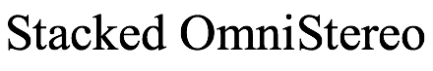
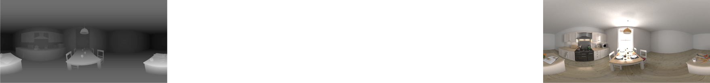
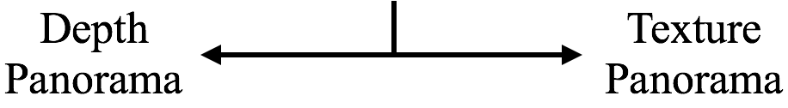
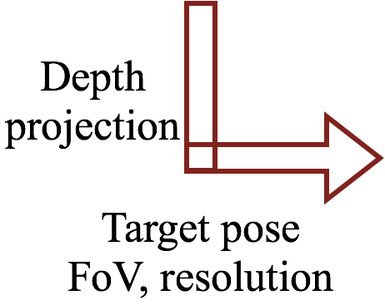
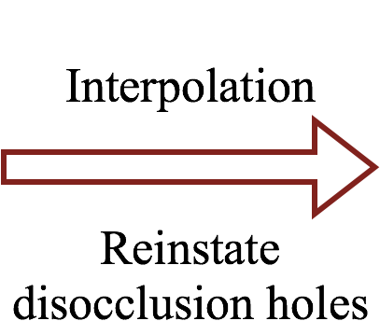
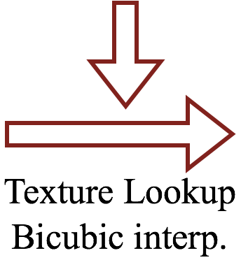
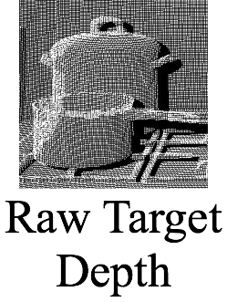
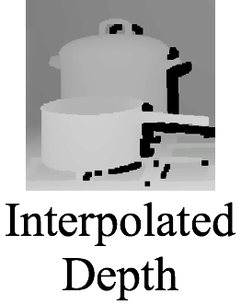
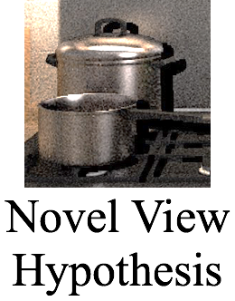
Hypothesis Generation (Once per Panorama)
Stanford University Jayant Thatte 29

Slide 30
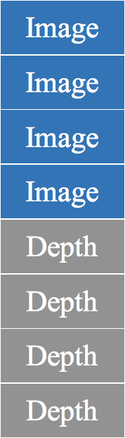
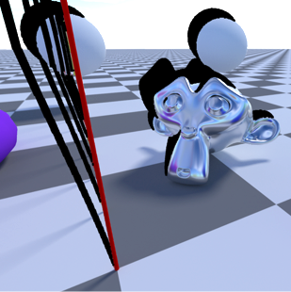
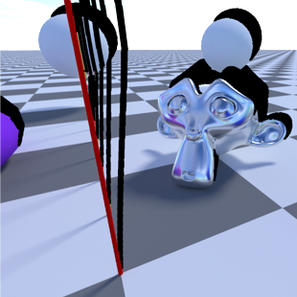
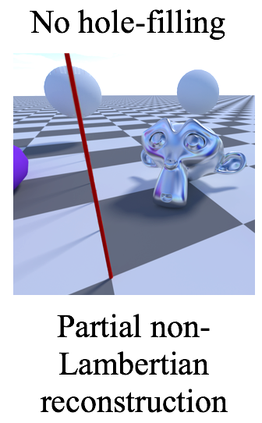
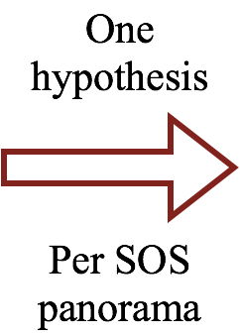
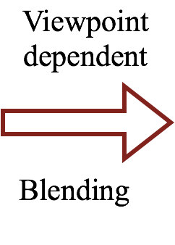
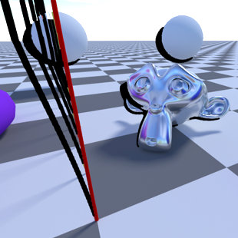
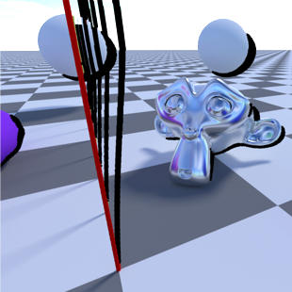
Hypothesis Merging (Once Per Frame)
Stanford University Jayant Thatte 30

Slide 31
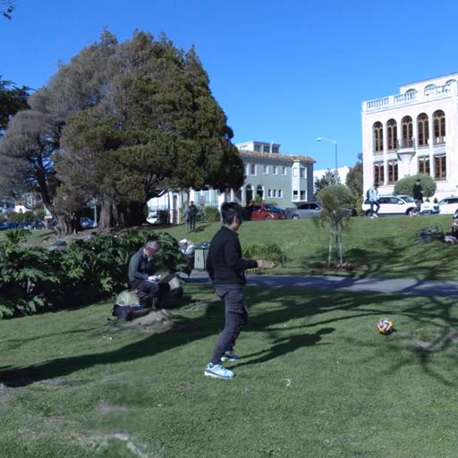
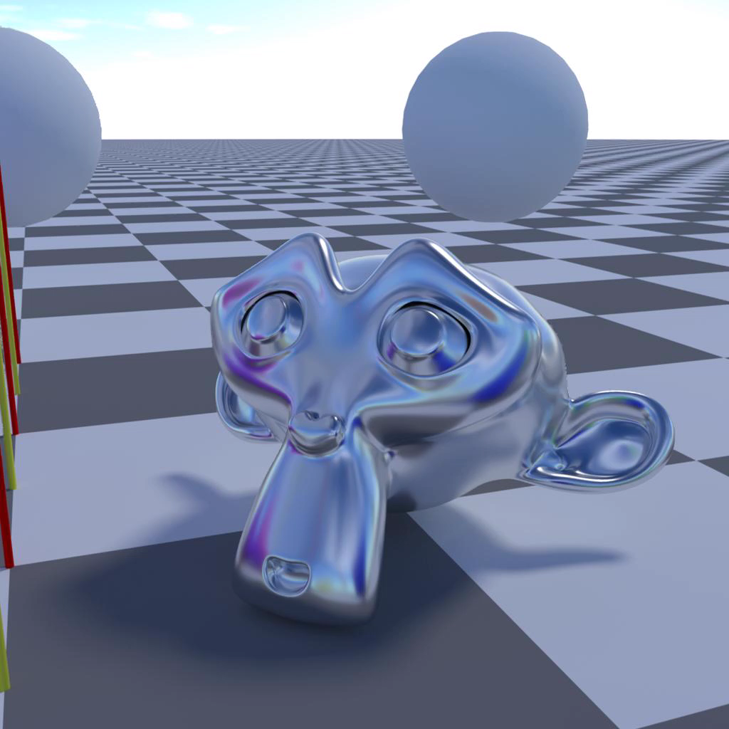
Motion Parallax Rendered from Stacked OmniStereo
Stanford University Jayant Thatte 31

Slide 32
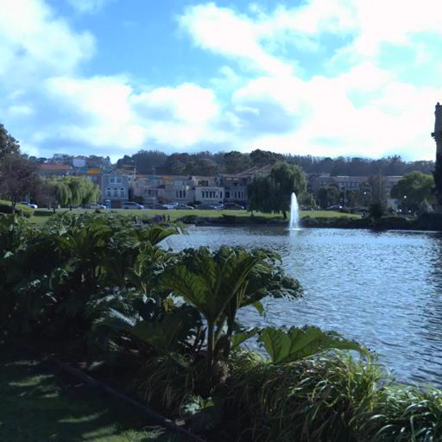
Additional Results
Stanford University Jayant Thatte 32

Slide 33
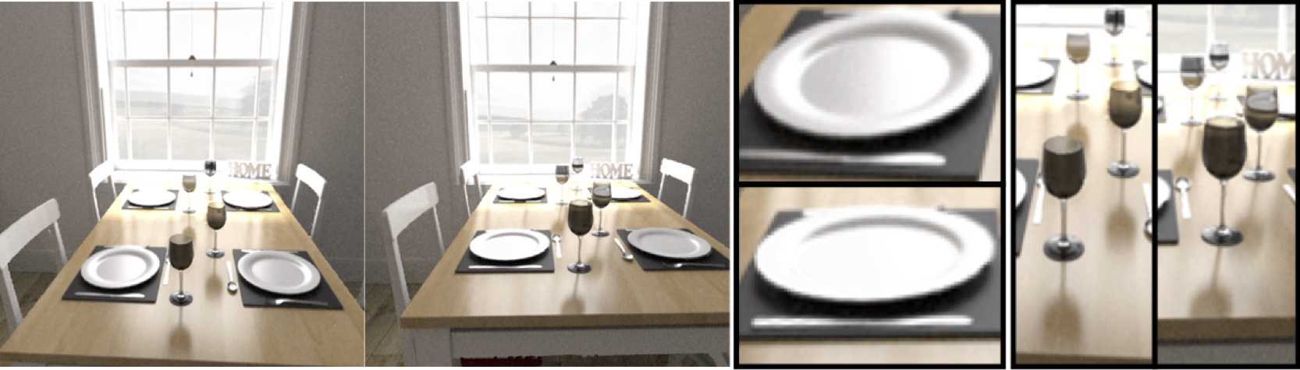
Specular Highlights
View 1
View 2
Magnified Cropped Regions
Stanford University Jayant Thatte 33

Slide 34
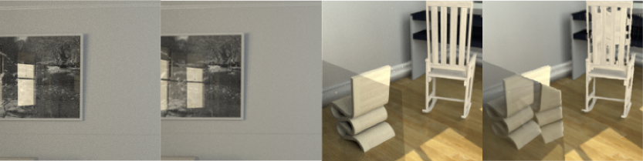
Limitations
Since SOS assigns single depth per pixel, reflections and transparent objects cannot be handled
Could be corrected using approach similar to [Sinha 2012]
Ground Truth
Synthesized
Ground Truth
Synthesized
Stanford University Jayant Thatte 34

Slide 35
Implementation Details
Hardware: 6 GB Nvidia GeForce GTX 980
Headset: Oculus Rift
Framerate: 45 fps
Resolution: Stereo rendering, 1344 x 1600 for each eye
Stanford University Jayant Thatte 35

Slide 36
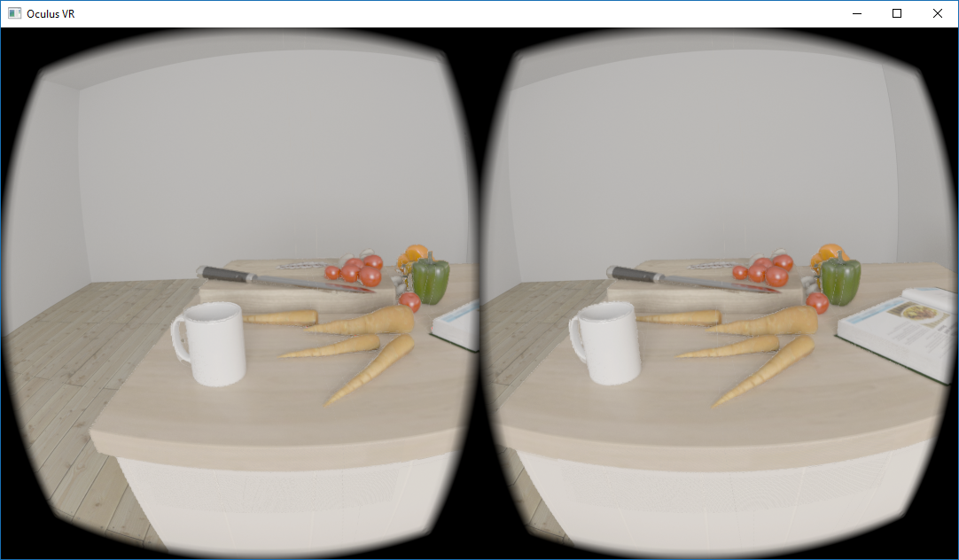
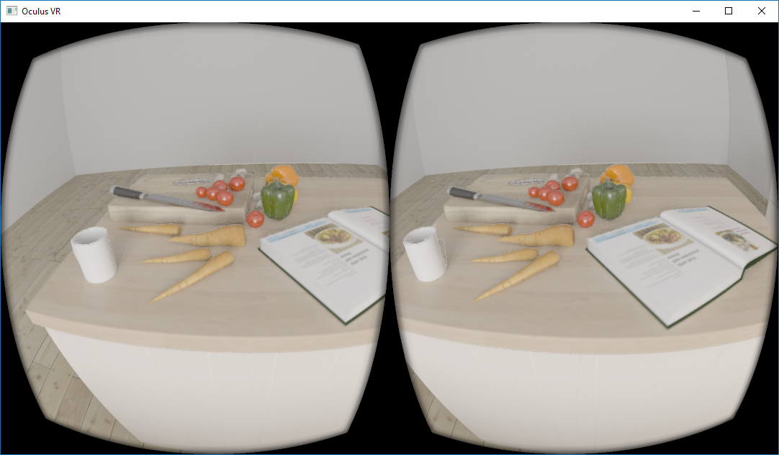
Notes:
Add Facebook scene example

Slide 37
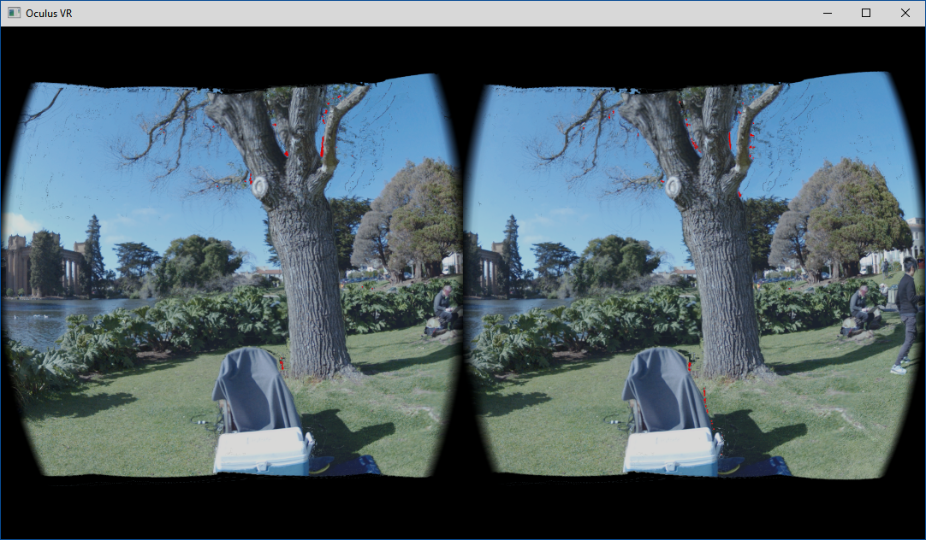
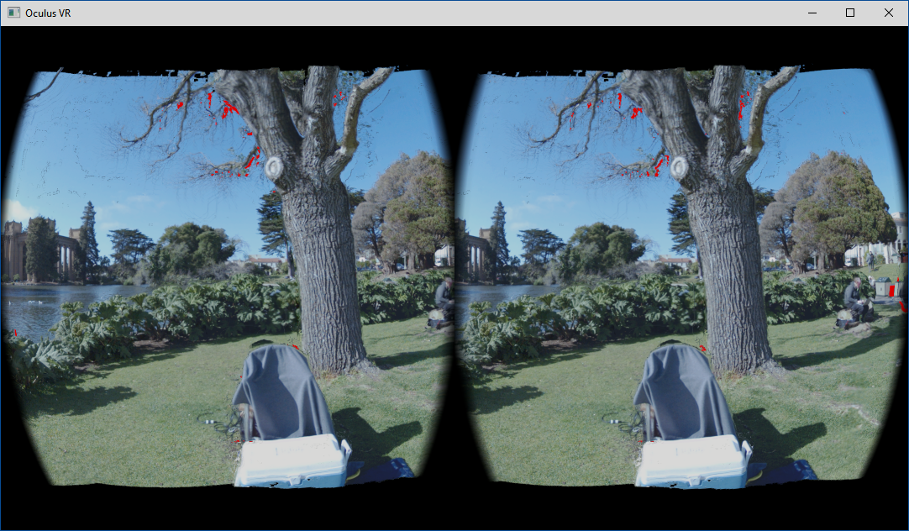
Scene source: Facebook Surround 360
Notes:
Add Facebook scene example

Slide 38
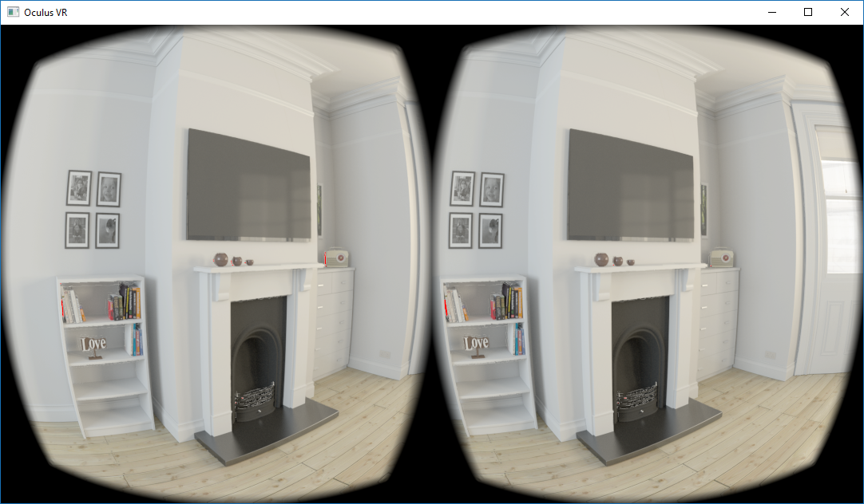
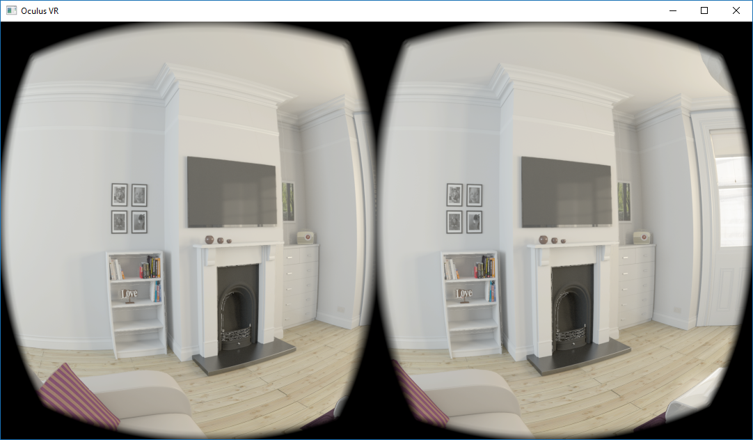
Notes:
Add Facebook scene example

Slide 39
Perceptual Factors
Stacked OmniStereo
Construction
Rendering

